Slide 1
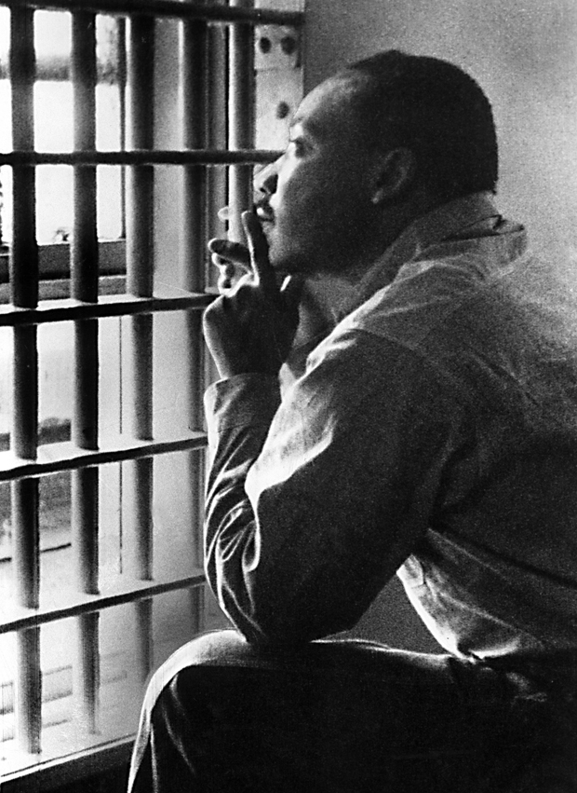
Before there was the dream… There was the letter.
Martin Luther King Jr.’s “Letter from Birmingham Jail”

Slide 2
Warm-up: Journal Prompts
During our “Pledge of Allegiance,” we commit ourselves to the idea of “liberty and justice for all.” What does the word “justice” mean to you? What connotations does it carry? Do we live in a just society today? Why or why not?
Imagine you have been suspended from school for disobeying or disrespecting a teacher. However, this incident took place because you stood up for a fellow student who you felt the teacher treated unfairly because of race, gender or religion. Write a letter to the principal respectfully explaining your actions.
When, if ever, is it acceptable to resist authority?

Slide 3
On April 16, 1963, civil rights leader Martin Luther King Jr., imprisoned in an Alabama prison cell, completed work on one of the seminal texts of the American Civil Rights Movement.

Slide 4
Seminal U.S. Document
Standards Focus:
sem·i·nal adjective \ˈse-mə-n^{ə}l\
: having a strong influence on ideas, works, events, etc., that come later : very important and influential

Slide 5
Peaceful Protest
King and nearly 50 other civil rights activists led a Good Friday demonstration to bring national attention to the brutal, racist treatment suffered by blacks in one of the most segregated cities in America—Birmingham, Alabama.
Convinced they had no other options, they ignored a recently passed ordinance that prohibited public gathering without a permit.

Slide 6
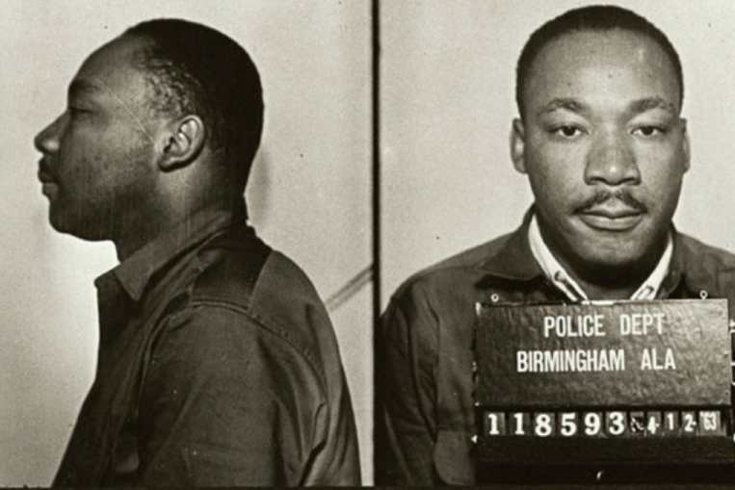
King’s Arrest
King was thrown into solitary confinement and denied his rightful access to his lawyers or wife.
President John F. Kennedy was urged to intervene on his behalf.

Slide 7
“Call for Unity” Clergy Letter
In jail, King received a smuggled copy of a Birmingham newspaper containing an open letter by eight local Christian and Jewish religious leaders.
The letter criticized King and his demonstrations, calling them “unwise and untimely.”

Slide 8
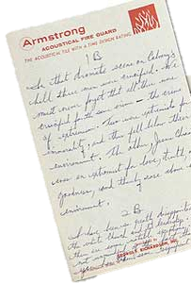
The Letter
Isolated in his cell, King began working on a response.
Without notes or research materials, King drafted an impassioned defense of his use of nonviolent, but direct, actions.

Slide 9
“Injustice anywhere is a threat to justice everywhere.”
After release, King continued his work in Birmingham
During “Child’s Crusade,” America watched, horrified, as police turned fire hoses and dogs on young protestors
Ku Klux Klan bombed Baptist church, killing four young African-American girls
King’s letter began to appear in newspapers around the country

Slide 10
The Legacy
Represents a crucial turning point in the American Civil Rights movement
Message continues to resonate around the world 50+ years later
Part of many American school curriculums
Included in more than 50 published anthologies
Translated in to more than 40 languages

Slide 11
Vocabulary
Admonish: warn
Clarion: loud and clear
Complacent: self-satisfied/indifferent
Concur: agree
Gadflies: people who annoy or provoke others
Incorrigible: incapable of being corrected
Moratorium: a suspension of activity
Paradoxical: seemingly absurd or contradictory
Profundity: deep insight; great depth of knowledge
Provincial: having narrow or limited concerns or interests
Repudiated: rejected as untrue or unjust
Sanctimonious: making a show of being morally superior to others; hypocritically spiritual
Unfettered: unrestrained

Slide 12
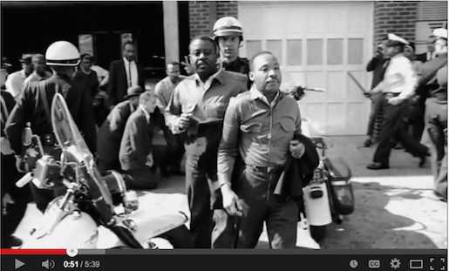
Watch it:
https://www.youtube.com/watch?v=XIpfCVt2eb4

