Slide 1
Drama as a Literary genre

Slide 2
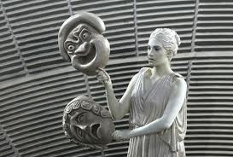
Drama
is the specific mode of fiction represented in performance. The term comes from a Greek word meaning "action" (Classical Greek: δρᾶμα, drama), which is derived from the verb meaning "to do" or "to act" (Classical Greek: δράω, draō).

Slide 3
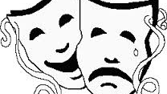
Types of drama

Slide 4
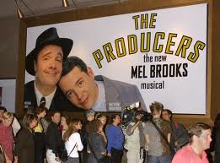
Comedy
When we talk about comedy, we usually refer to plays that are light in tone, and that typically have happy endings. The intent of a comedic play is to make the audience laugh. In modern theater, there are many different styles of comedy, ranging from realistic stories, where the humor is derived from real-life situations, to outrageous slapstick humor.

Slide 5
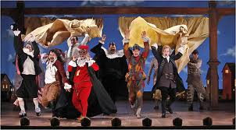
Farce
Farce is a sub-category of comedy, characterized by greatly exaggerated characters and situations. Characters tend to be one-dimensional and often follow stereotypical behavior. Farces typically involve mistaken identities, lots of physical comedy and outrageous plot twists.

Slide 6
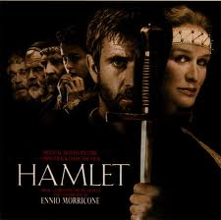
tragedy
A type of drama in which the characters experience reversals of fortune, usually for the worse. In tragedy, catastrophe and suffering await many of the characters, especially the hero. Examples include Shakespeare's Othello and Hamlet; Sophocles' Antigone and Oedipus the King, and Arthur Miller's Death of a Salesman.

Slide 7
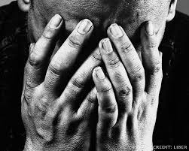
Pathos A quality of a play's action that stimulates the audience to feel pity for a character. Pathos is always an aspect of tragedy, and may be present in comedy as well.

Slide 8
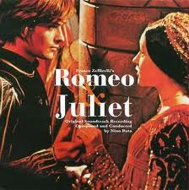
Traditional drama
Serious drama written in verse featuring noble characters in an irretrievable situation that elicits their immense capacity for suffering and promise of a better tomorrow, the vision of the play is dark. Ex. Romeo and Juliette

Slide 9
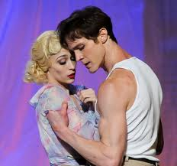
Modern drama
Modern ordinary characters rise to the status of exceptional characters facing a tragic web of circumstances and personal weaknesses that spell their doom in an unsympathetic world. Ex. Streetcar Named Desire

Slide 10
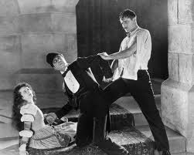
Melodrama Melodrama is another type of exaggerated drama. As in farce, the characters tend to be simplified and one-dimensional. The formulaic storyline of the classic melodrama typically involves a villain a heroine, and a hero who must rescue the heroine from the villain.

Slide 11
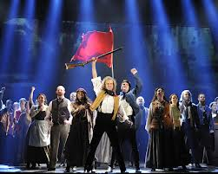
Musical In musical theater, the story is told not only through dialogue and acting but through music and dance. Musicals are often comedic, although many do involve serious subject matter. Most involve a large cast and lavish sets and costumes.

Slide 12
As a student of drama it is important to be able recognize these different types of drama. Be aware that in modern theater, the lines between these types of drama are often quite blurred, with elements of comedy, drama and tragedy residing in the same play.

Slide 13
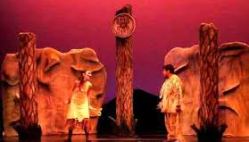
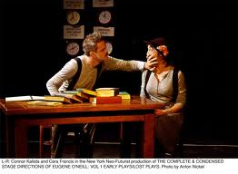
Elements of drama

Slide 14
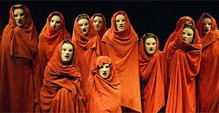
chorus
A group of characters in Greek tragedy (and in later forms of drama), who comment on the action of a play without participation in it. Their leader is the choragos. Sophocles' Antigone and Oedipus the King both contain an explicit chorus with a choragos. Tennessee Williams's Glass Menagerie contains a character who functions like a chorus.

Slide 15
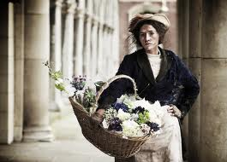
Dramatis Personae
Latin for the characters or persons in a play. Included among the dramatis personae of Miller's Death of a Salesman are Willy Loman, the salesman, his wife Linda, and his sons Biff and Happy.

Slide 16
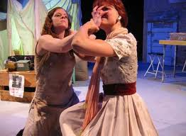
dialogue
The conversation of characters in a literary work. In fiction, dialogue is typically enclosed within quotation marks. In plays, characters' speech is preceded by their names.

Slide 17
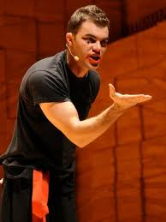
Monologue
A speech by a single character without another character's response.

Slide 18
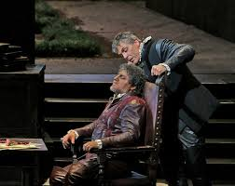
aside
Words spoken by an actor directly to the audience, which are not "heard" by the other characters on stage during a play. In Shakespeare's Othello, Iago voices his inner thoughts a number of times as "asides" for the play's audience.

Slide 19
soliloquy
A speech in a play that is meant to be heard by the audience but not by other characters on the stage. If there are no other characters present, the soliloquy represents the character thinking aloud. Hamlet's "To be or not to be" speech is an example.

Slide 20
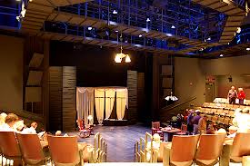
staging
The spectacle a play presents in performance, including the position of actors on stage, the scenic background, the props and costumes, and the lighting and sound effects. Tennessee Williams describes these in his detailed stage directions for The Glass Menagerie and also in his production notes for the play.

