Slide 1
Major literary movements

Slide 2
Classic Literature (Around 800 BC to 400 BC
Of the literature of ancient Greece only a relatively small proportion survives
Supreme quality and themes
until the mid-19th century the greater part of the literature of the Western world was produced by writers who were familiar with the Greek tradition, either directly or through the medium of Latin

Slide 3
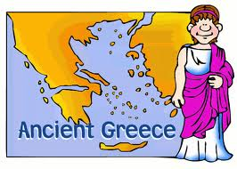
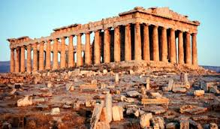

Slide 4
Classic Greek Writers
Homer
The Iliad, The Odyssey
Sapho
Hymn to Aphrodite and other Lyric Poems
Aesop
Fables
Plato
Allegory of the Cave
Euripides (great writer of Greek Tragedies)
Oedipus the King

Slide 5
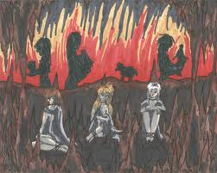
Plato’s allegory of the cave

Slide 6
More Classic Greeks
Plato (philosopher, chronicler of Socrates)
The Republic
Aristotle (philosopher)
Poetics, On the Soul
Hippocrates
The Hippocratic Oath

Slide 7
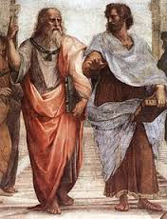
The Hippocratic Oath
Aristotle and Plato

Slide 8
Renaissance Literature
The Renaissance in Europe was in one sense an awakening from the long slumber of the Dark Ages
The printing press was put into service around 1440 by Johannes Guttenberg.
The dominant forms of English literature during the Renaissance were the poem and the drama. Among the many varieties of poetry one might have found in sixteenth century England were the lyric, the elegy, the tragedy, and the pastoral.

Slide 9
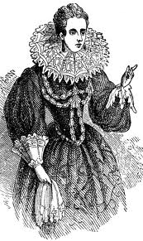

Slide 10
The printing press was put into service around 1440 by Johannes Guttenberg.
Thanks to the sudden increase in printed material, communal reading and the oral tradition gradually gave way to silent, individual reading.
At the time, silent reading was considered something of a novelty, and there were even those who looked upon the practice with suspicion

Slide 11
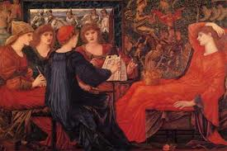
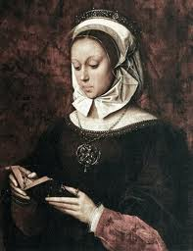
Reading was no longer the privilege of a very few!

Slide 12
The dominant forms of English literature during the Renaissance were the poem and the drama.
Among the many varieties of poetry one might have found in sixteenth century England were the lyric, the elegy, the tragedy, and the pastoral.
English poetry of the period was ostentatious, repetitious, and often betrayed a subtle wit.

Slide 13
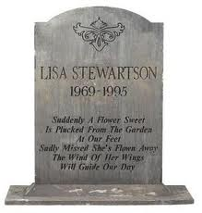
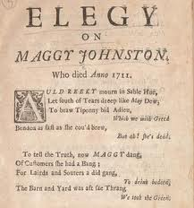

Slide 14
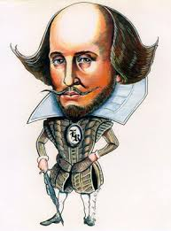
Famous Renaissance Writers
William Shakespeare, of course! (1564-1616)
Wrote many plays, including tragedies and comedies
How many of his plays and poems can you name?

Slide 15
Julius Caesar
Hamlet
Macbeth
A Midsummer Night’s Dream
Taming of the Shrew
The Tempest
And many more!

Slide 16
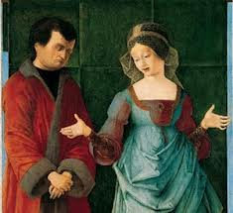
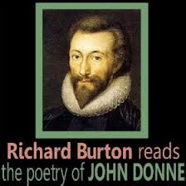
John Donne, (1572-1631)
Wrote many poems about death, love and despair
“A Valediction Forbidding Mourning”
The Flea
The Good Morrow

Slide 17
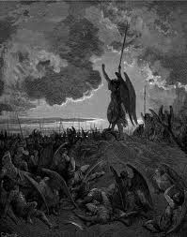
John Milton (1608-1674)
“Paradise Lost” is one of his greatest works.
Edmund Spenser (1552-1599)
Prosopopoia: or Mother Hubberds Tale

Slide 18
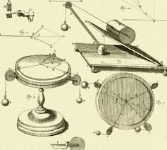
The Enlightenment
The Enlightenment, sometimes referred to as the Age of Reason, was a confluence of ideas and activities that took place throughout the eighteenth century in Western Europe, England, and the American colonies.

Slide 19
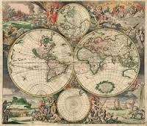
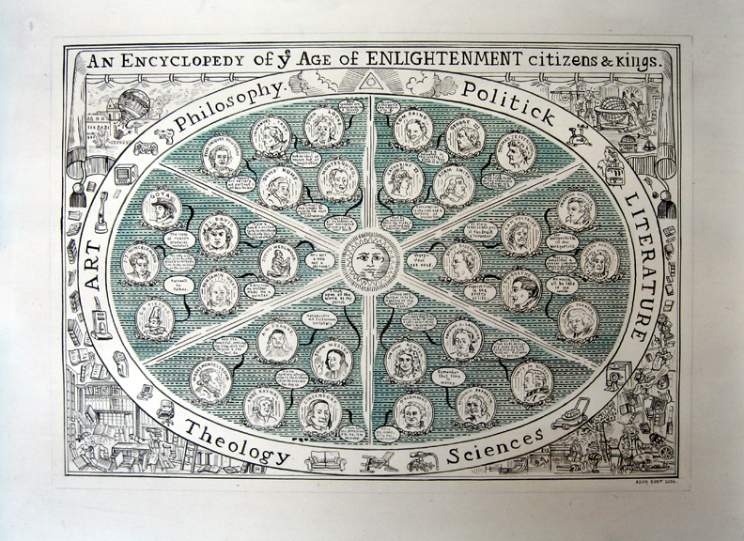

Slide 20
Scientific rationalism, exemplified by the scientific method, was the hallmark of everything related to the Enlightenment.
Major philosophers and economist hail from this era
Voltaire (philosopher)
Jean-Jacques Rousseau (economist)
Isaac Newton (scientist)
Jonathan Swift (Gulliver’s Travels)

Slide 21
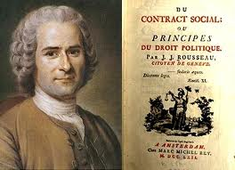
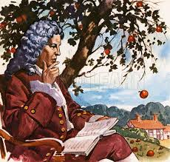
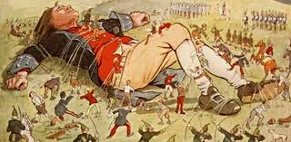
Sir Isaac Newton

Slide 22
Neoclassicism,
A revival in literature in the late 17th and 18th centuries, characterized by a regard for the classical ideals of reason, form, and restraint.
a preference for rationality, clarity, restraint, order, and decorum, and for general truths rather than particular insights.
The Neoclassical Period of the eighteenth century included very strict expectations regarding the structure and content of poetry

Slide 23
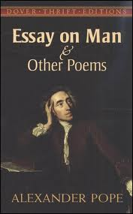
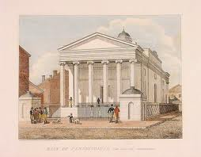

Slide 24
Romanticism
Romanticism is concerned with the individual more than with society. The “natural man.”
There was a downgrading of the importance and power of reason, clearly a reaction against the Enlightenment mode of thinking.

Slide 25
By the dawn of the nineteenth century, experimentation with new styles and subjects became much more acceptable.
The high-flown language of the previous generation’s poets (neoclassicists) was replaced with more natural cadences and word choice.

Slide 26
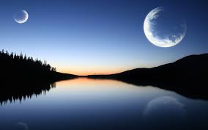
Nature for the Romantics becomes a means for divine revelation
In terms of poetic form, rhymed stanzas were slowly giving way to blank verse, an unrhymed but still rhythmic style of poetry

Slide 27
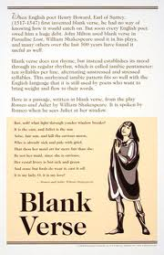

Slide 28
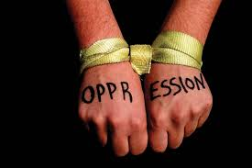
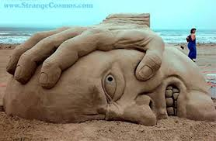
Romantics were attracted to rebellion and revolution, especially concerned with human rights, individualism, freedom from oppression;

Slide 29
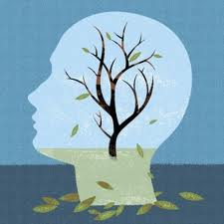
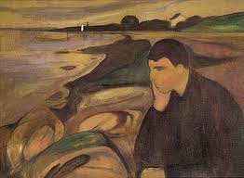
There was emphasis on introspection, psychology, melancholy, and sadness. The art often dealt with death, transience and mankind’s feelings about these things.

Slide 30
Famous Romantics!
Edgar Allen Poe, (1809-1849)
“The Raven”
“Annabel Lee”
“The Tell-tale Heart”
“Murders in the Rue Morgue”
“The Pit and the Pendulum”
And many more!

Slide 31
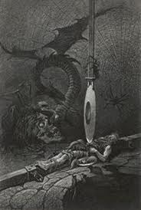
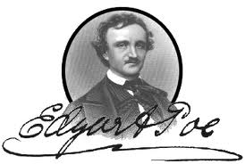

Slide 32
Mary Shelley, (1797-1851)
Frankenstein
Herman Melville, (1819-1891)
Moby Dick
Longfellow, Henry Wadsworth (1807-1882)
Song of Hiawatha
Irving, Washington (1783-1859)
The Legend of Sleepy hollow

Slide 33
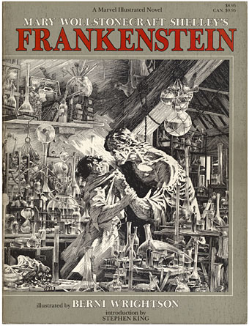
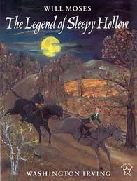

Slide 34
Realism
In American literature, the term "realism" encompasses the period of time from the Civil War to the turn of the century.
Events in literature are plausible
Diction is natural vernacular, not heightened or poetic; tone may be comic, satiric, or matter-of-fact.

Slide 35
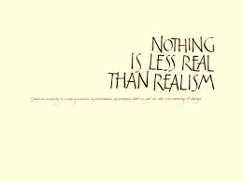
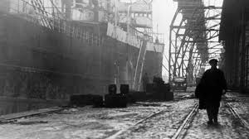
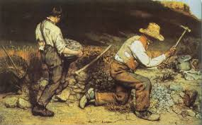

Slide 36
Charles Dickens (England)
His writing reflects England’s class society at the time.
His descriptions of poverty are stark and unadorned.
Some of his works are:
Great Expectations
A Christmas Carol (novella)
A Tale of Two Cities

Slide 37
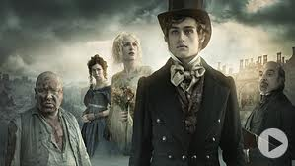
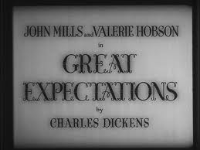
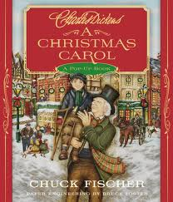
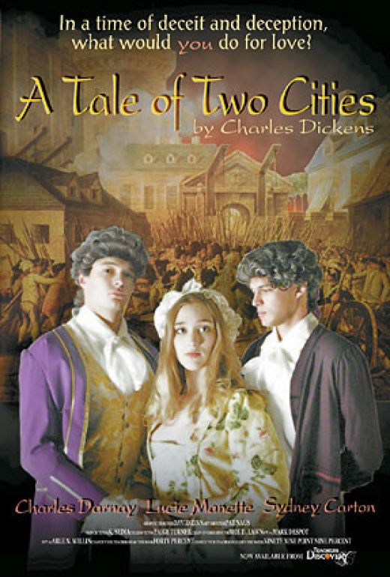

Slide 38
Samuel Clemens (Mark Twain) 1835-1910
American author
The Adventures of Tom Sawyer
Huckleberry Finn
The Prince and the Pauper
And many more!

Slide 39
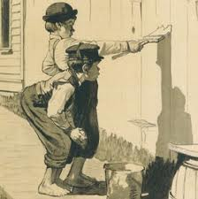
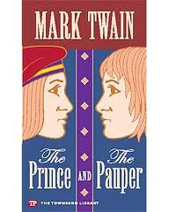
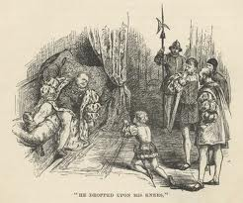

Slide 40
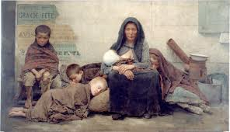
Naturalism (1890s-1920s)
A literary movement seeking to depict life as accurately as possible, without artificial distortions of emotion, idealism, and literary conventions.
It asserts that human beings exist entirely in the order of nature

Slide 41
Human beings do not have souls.
Any attempt to participate in a religious or spiritual world beyond the biological realm of nature, is an act of self-delusion and wish-fulfillment

Slide 42
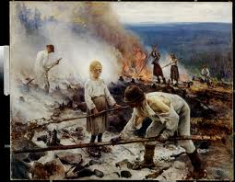
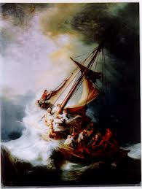
The end of the naturalistic novel is usually unpleasant or unhappy
Examples of this include Stephen Crane's "The Open Boat," which pits a crew of shipwrecked survivors in a raft against starvation, dehydration, and sharks in the middle of the ocean.

Slide 43
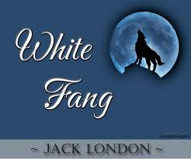
Jack London's "To Build a Fire," which reveals the inability of a Californian transplant to survive outside of his "natural" environment as he freezes to death in the Alaskan wilderness.

Slide 44
Modernism
Early twentieth century-until the end of World War II
Literature is marked by the desire to break away from established traditions
a quest to find fresh ways to view man's position or function in the universe
experiments in form and style, particularly with fragmentation

Slide 45
Modern Authors
George Bernard Shaw, (1856-1950)
Pygmalion
Joseph Conrad, (1857-1924)
Heart of Darkness
Ernest Hemingway, (1899-1961)
A Farewell to Arms
For Whom the Bell Tolls
And many More!

Slide 46
