Slide 1
Guiding Question:
How can an author use ethos, logos and pathos to shape and strengthen their argument?

Slide 2
Rhetoric
the art of using language to persuade

Slide 3
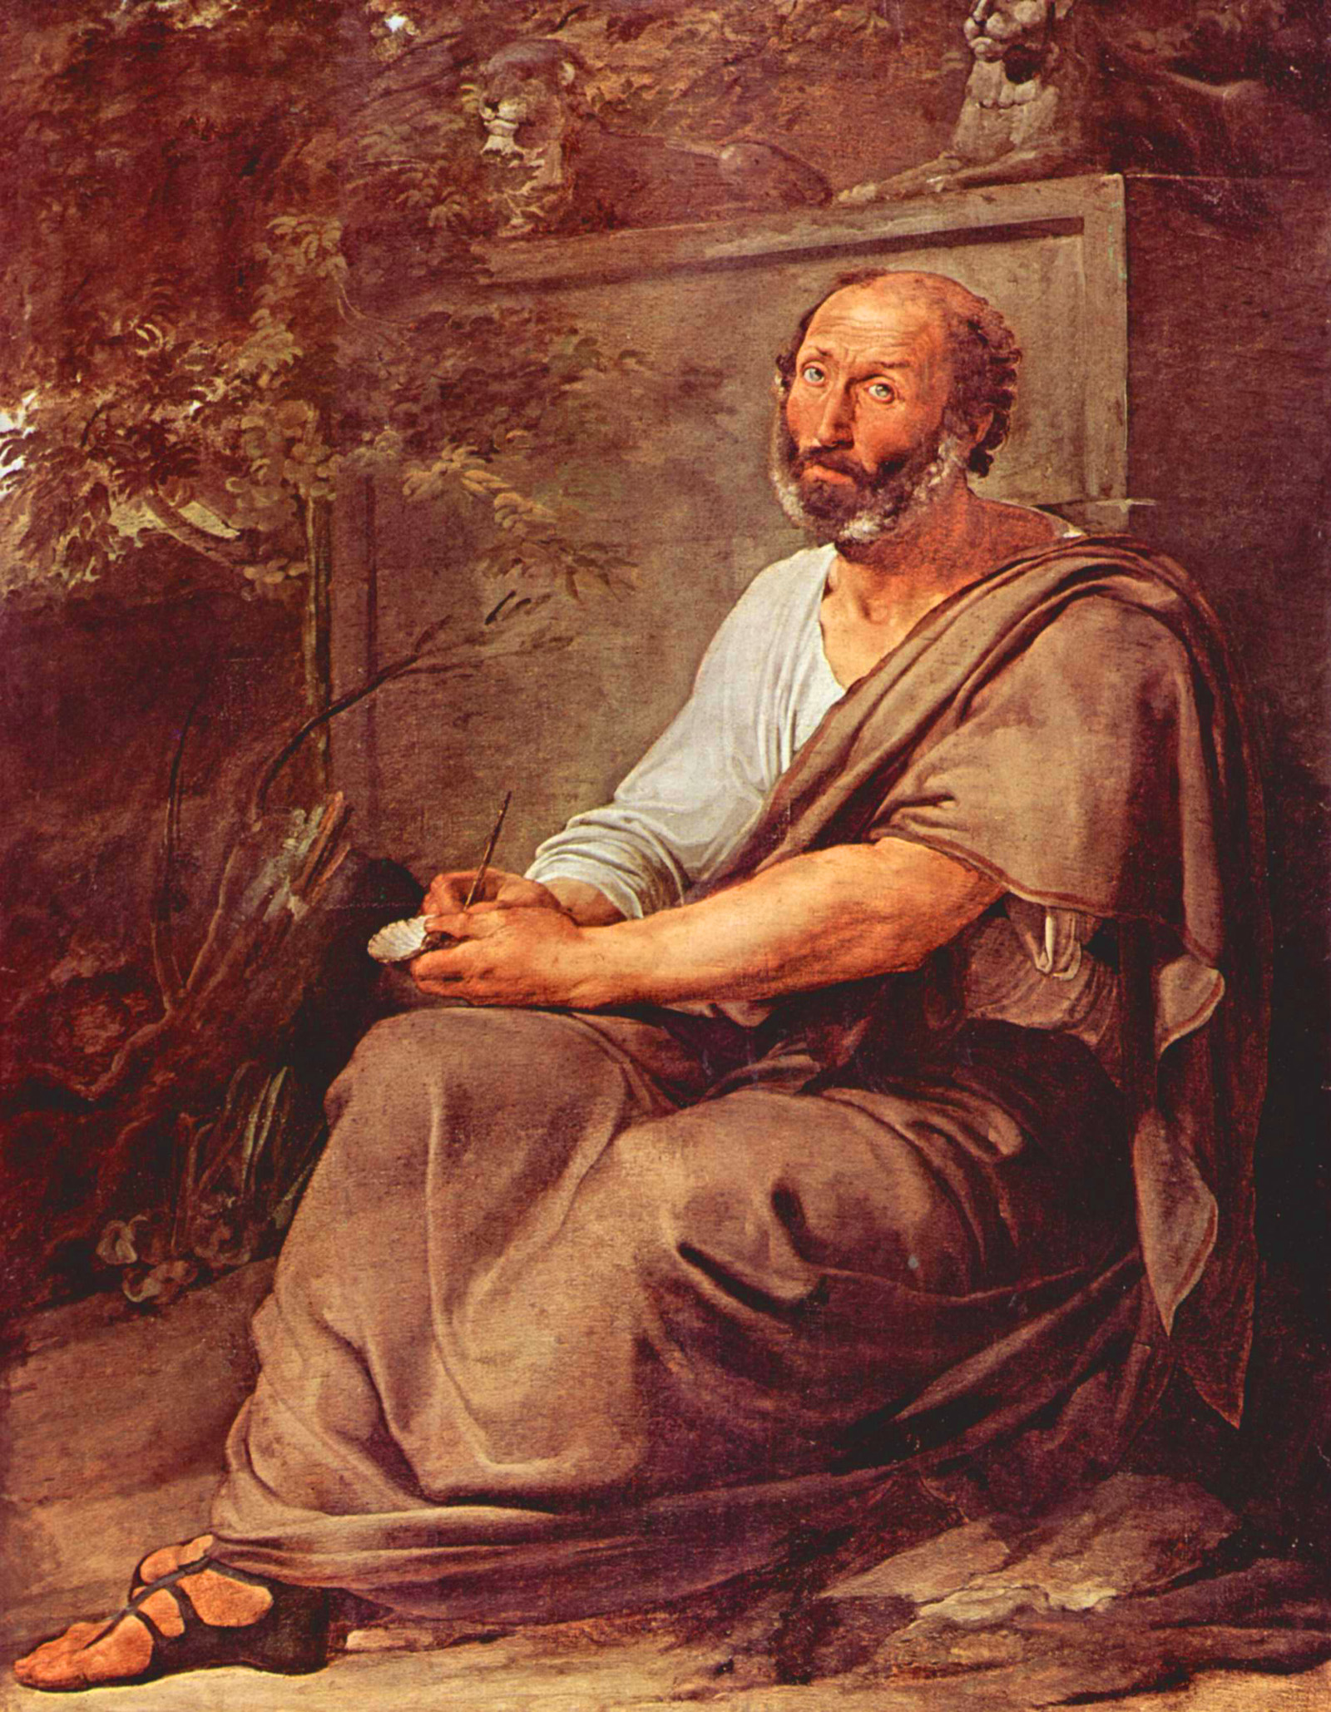
Aristotle
Who’s to blame?

Slide 4
Aristotle
Three modes of persuasion.

Slide 5
1. Ethos 2. Logos 3. Pathos

Slide 6
1. Ethos
someone’s character, credibility, or identity

Slide 7
How you establish Ethos
Applying to NHS, running for student government
“I am an honors student…”
“I have experience in student government…”
Defend yourself to a teacher
“Please, you know that I don’t normally try to turn things in late”
The way you dress, present, identify yourself
Think: How would you dress for an interview?

Slide 8
A writer/speaker is establishing their Ethos when they…
list their credentials
When a professor includes ‘Ph.D’ by their name, or when a business person includes their MBA title on their card
talk about their experiences
“If anyone knows about this field of study, it’s me!”
talk about their behavior
“I’ve been working with this charity for 10 years”

Slide 9
Two types of Ethos-
we’ll call them explicit and implicit
* Explicit= Ethos that the writer
or speaker verbally tells you of.
(Credentials listed, experiences mentioned)
* Implicit= Ethos that the writer or
speaker does not directly talk about.
(If a doctor wears a white coat,
they don’t say to their patients: “Let me
clarify, this white coat means
I’m a doctor!”

Slide 10
Writers/Speakers can also appeal to the ethos of their audience.
…They can appeal to their sense of identity
“Americans do not tolerate injustice”
“Don’t be the type of person who allows
this to happen…”
…They can assert a shared ethos:
“We’re all in this together as Americans”

Slide 11
Let’s look for examples of Ethos in
A Letter from a Birmingham Jail
A Bit of Background Info:
…Martin Luther King writes this letter from inside of a jail after being arrested for protesting segregation laws. Local clergymen, or Christian ministers, have challenged King, calling him an ‘outside agitator’ who comes in from out of town to cause trouble.

Slide 12
Let’s look for examples of Ethos in
A Letter from a Birmingham Jail
…While it’s hard for most Americans today to imagine that reasonable people would not appreciate Martin Luther King Jr.’s involvement in the Civil Rights movement, keep in mind that nobody knew who he was at first. He had not established his identity as a moral leader. He introduces himself to America through this letter.

Slide 13
Let’s look for examples of Ethos in
A Letter from a Birmingham Jail
As we read this first section, let’s highlight (or underline) lines in which King establishes his ethos or appeals to his audience’s ethos and comment on the effect these examples have on his argument.

Slide 14
2. Logos
appealing to logic

Slide 15
How you’re familiar with Logos
If… then… statements are attempts to make a logical argument
“If John can get a car, then I should get one, too!”
If you’ve ever used statistics in your writing
“Studies show that America now has more obese citizens than ever.”
Using anecdotes to back up your points
“Not all students can handle balancing school and a job, take my friend Bill…”

Slide 16
A writer/speaker is drawing on logos, or logic, when they…
-Use examples from history, current events, or personal anecdotes*
“History shows that America has never been able to deport all of its undocumented workers…”
*Anecdote= a story from one’s own personal experience
-Posit logical, hard-to-refute statements:
“If we haven’t been able to do that in the past, how could we be able to now?”

Slide 17
A writer/speaker is drawing on logos, or logic, when they…
-Use concessions to address questions and counter points.
Concession= when a writer acknowledges a counterpoint or question that their audience . Also known as anticipating reader concerns or objections
Counterpoint= a point that refutes or challenges what someone is trying to argue. Also called a rebuttal or counterargument to an anticipated objection.
“While you may be thinking that things have changed since this study, according to my research, the surprising truth is that…”

Slide 18
A writer/speaker is drawing on logos, or logic, when they…
-Cite learned people, authoritative studies, or proven statistics
“Harvard Law professor Sean Dumbledore agrees that it is impossible to deport all undocumented workers”

Slide 19
A writer/speaker is drawing on logos, or logic, when they…
-Use rhetorical questions to develop a point
“How is the government supposed to send that many people back to their countries of origin?”

Slide 20
Let’s look for examples of Logos in
A Letter from a Birmingham Jail
As we read this second section, let’s highlight (or underline) lines in which King uses logos and comment on the effect these examples have on his argument.

Slide 21
3. Pathos
appealing to emotions

Slide 22
How you use Pathos
Depict consequences:
“Fine, mom, don’t let me go out. I’m just going to miss out on the best years of my life.”
“Come on, go to the fair with us, you’ll have a blast!”
Puppy-Dog face
Guilt

Slide 23
A writer/speaker is drawing on pathos when they…
Paint an emotionally charged image
“Think of all the sad animals at the pound, waiting to get adopted.”
Use ‘emotive’ words
“I was thrilled to see the fair was in town!”
-Imply that you should feel a certain way
“You should be outraged!”

Slide 24
How does the word Pathos relate to the word pathetic?
Something that is ‘pathetic’ in the specific sense, is sad, it stirs pity…
More generally, the word ‘pathetic’, as in a ‘pathetic appeal’ means to appeal to emotions- be they sad, happy, angry, etc.

Slide 25
Let’s look for examples of Pathos in
A Letter from a Birmingham Jail
As we read this third section, let’s highlight (or underline) lines in which King uses pathos and comment on the effect these examples have on his argument.

Slide 26
Now Let’s take a minute to review our exit slip and mark our scales with stickers

