Slide 1
To Kill a Mockingbird Literary Devices Academic League
May the Best Group Win!

Slide 3
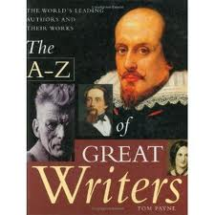
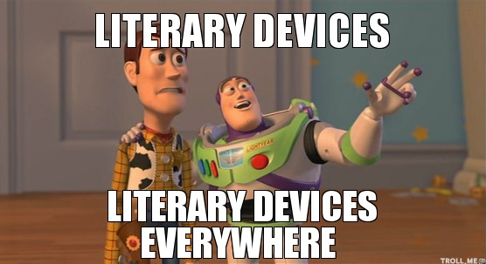
What are literary devices? Elements used by the author to improve the quality of his writing.

Slide 4
These are your options:
figurative language (metaphor, simile, personification, hyperbole)
imagery
symbol
motif
foreshadowing
Theme
Allusion
irony (verbal, situational, dramatic)

Slide 5
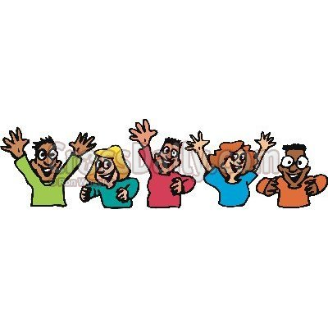
These are the rules:
Read the examples on each slide, and discuss your options with your group.
When the bell rings, lift up the card that has the letter that represents the answer your group decided on.
Be prepared to defend your answer! Some examples may actually have more than one answer!
Choose the best answer.

Slide 6
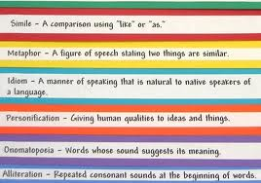
If the answer is figurative language:
You must specify which type!

Slide 7
If the slide shows examples of theme:
You must also specify what you think the theme is according to the examples.

Slide 8
If the slide shows examples of irony
You must specify which type

Slide 9
If the slide shows examples of allusion:
You get extra points if you can identify the source of the allusion!

Slide 10
Are you ready?

Slide 11
“Jem motioned me to follow…His face was grave. “Scout, try not to antagonize Aunt Alexandra..”
“Atticus sighed. …’ Scout, you aren’t old enough to understand some things yet, but there’s been some high talk around town to the effect that I shouldn’t do much about defending this man. It’s a peculiar case…”
“Scout needs to keep her head and learn soon, with what’s in store for her these next few months…”

Slide 12
Answer
Foreshadowing- all three quotes indicate that events will occur that will deeply affect the characters.

Slide 13
“He was sitting on the bed and it was easy to grab his front hair and land him one on the mouth.”
Scout fights with her cousin after he reveals what his family thinks of Atticus
‘ “Don’t you touch him!” I kicked the man swiftly.’
Scout fights with Walter Cunningham after he gets her in trouble at the school
Scout beats up Dill when he isn’t paying enough attention to him.

Slide 14
Answer
All these quotes and examples form a motif. In all cases, there is a fight, a struggle. The physical fights and conflicts mirror the theme of the internal struggle that Atticus and other characters go through in order to do the right thing.
They form a motif because they are recurring elements that form a pattern, and that are directly related to the theme of prejudice and the fight against it.

Slide 15
The mockingbird
Tim Johnson (the rabid dog)
Camellias –“ (Jem) did not begin to calm down until he had cut the tops of every camellia bush Mrs. Dubose owned…”

Slide 16
Answer
They are all examples of symbolism.
The mockingbird symbolizes an innocent who suffers unnecessarily and unjustly.
Tim Johnson, the rabid dog, may represent the “madness” or “sickness” of prejudice that permeates the town. Atticus is the one person willing to face it and vanquish it.
The fury with which Jem cuts of the heads of Mrs. Dubose’s camellias may symbolize his struggle to erase prejudice and hatred from Maycomb.

Slide 17
Atticus sends Jem to read for Mrs. Dubose who struggles to beat her morphine addiction before she dies. ”… you know you're licked before you begin but you begin anyway and you see it through no matter what" he tells Jem.
Atticus refuses to carry a gun to protect Tom Robinson from angry farmers.
“Simply because we were licked a hundred years before we started is no reason for us not to try and win.”
Atticus takes on Tom Robinson’s case despite the repercussions on his family.
Jem refuses to leave his father's side during the showdown with farmers at the jailhouse

Slide 18
Answer: Theme
All these quotes support the theme that some people will stand up for what’s right despite difficulties or harm to themselves, and even when their fight seems futile.

Slide 19
The name of Atticus Finch
“Mockingbirds don’t do one thing to but make music for us to enjoy…It is a sin to kill a mockingbird”
“Nothing is more deadly than a deserted, waiting street. The trees were still, the mockingbirds were silent….” (Chapter 10 before the rabid dog appears)

Slide 20
Answer:
All these quotes/examples make reference to birds (the name Finch, the mockingbird, etc.) Birds, and specifically mockingbirds, are a recurring symbol throughout the novel that together form a motif.

Slide 21
“I swear, Scout, sometimes you act so much like a girl it’s mortifying”
“Boo was about six-and-a-half feet tall, judging from his tracks; he dined on raw squirrels and any cats he could catch… there was a long jagged scar that ran across his face…”
Scout hates to wear dresses and she finds the accusation that she "acts like a girl" highly offensive
"As you grow older, you'll see white men cheat on black men every day of your life, but let me tell you something and don't forget it - whenever a white man does that to a black man, no matter who he is, how rich he is, or how fine a family he comes from, that white man is trash."

Slide 22
Answer:
All these examples refer to the theme of prejudice. These examples include racial prejudice, prejudice against women, and prejudice against someone who is different (Boo Radley).
Remember that theme is a general statement about human nature so the theme would be that human beings have the capacity to reduce and belittle others who may be different or defenseless.

Slide 23
The feeling grew until the atmosphere in the courtroom was exactly the same as a cold February morning, when the mockingbirds were still, and the carpenters had stopped hammering on Miss Maudie's new house, and every wood door in the neighborhood was shut as tight as the doors of the Radley Place. A deserted, waiting, empty street, and the courtroom was packed with people. A steaming summer night was no different from a winter morning

Slide 24
Answer:
This quote is an example of foreshadowing. The author uses the description of the setting to indicate that something important is about to happen.
This quote also includes imagery that contributes to the mood that is part of the foreshadowing. As you can see, an author may use multiple devices in a single quote.

Slide 25
Jem announces to Dill that Scout has known how to read since she was a baby.
Atticus reads to the children from newspapers and magazines as if they are adults who can understand issues at his level.
By the time Scout attends her first day of school she is highly literate, far surpassing the other children in the classroom and frustrating her teacher whose task is to teach her students according to a predetermined plan.
Atticus uses high level vocabulary with his children.

Slide 26
Answer:
These are examples that indicate a recurring theme. They all relate to the importance of literacy and the ability to read and write proficiently and at high levels of understanding.
Keep in mind that the author does not correlate literacy with formal education. The novel in fact, often ridicules public education. The theme or underlying message is that literacy and higher thinking skills are a product of the home environment more than of schools.

Slide 27
‘I haven’t shot a gun in thirty years—” Mr. Tate almost threw the rifle at Atticus. ‘I’d feel mighty comfortable if you did now,” he said. In a fog, Jem and I watched our father take the gun and walk out into the middle of the street. He walked quickly, but I thought he moved like an underwater swimmer: time had slowed to a nauseating crawl.”
“You never really understand a person until you climb into his skin and walk around in it”

Slide 28
Answer
Both quotes are examples of foreshadowing. In the first one, the author uses vivid imagery and suspense to foreshadow what will happen next.
The second quote indicates a central theme, and it foreshadows events to come later, especially at the end when the Scout finally understands what it really means.

Slide 29
"Her face was the color of a dirty pillowcase, and the corners of her mouth glistened with wet, which inched like a glacier down the deep grooves enclosing her chin. Old-age liver spots dotted her cheeks, and her pale eyes had black pinpoint pupils. Her hands were knobby, and the cuticles were grown up over her fingernails“

Slide 30
Answer:
This is a clear example of imagery. The author uses rich, vivid detail to help us visualize Mrs. Dubose.

Slide 31
"Every night-sound I heard from my cot on the back porch was magnified three-fold; every scratch of feet on gravel was Boo Radley seeking revenge, every passing Negro laughing in the night was Boo Radley's insane fingers picking the wire to pieces; the chinaberry trees were malignant, hovering, alive"

Slide 32
Answer:
Another example of imagery. Note how the author uses descriptions of sights and sounds to create a mood of suspense and terror.

Slide 33
“Are we as poor as the Cunninghams?” “Not exactly. The Cunninghams are country folks, farmers, and the crash hit them hardest.”
“Let this cup pass from you,eh?” (p. 88)
“Thus we came to know Dill as a pocket Merlin.”
“Why, one sprig of grass can ruin a whole yard…Miss Maudie’s face likened such an occurrence unto an Old Testament pestilence.” (p.42)

Slide 34
Answer: All of these quotes are allusions.
The “crash” alludes to the stock market crash that is directly related the Great Depression.
Biblical reference from the New Testament; this is what Jesus prayed right before his passion. Uncle Jack quotes this to Atticus after they had a conversation about the hardships that Tom’s trial would bring upon Atticus and his family.
“Merlin” is the wizard who is King Arthur’s (of the Round Table) mentor.
The “pestilence” alludes to the biblical plagues that God unleashes on Egypt (in the book of Exodus)

Slide 35
The Maycomb ladies talk to Aunt Alexandra about Mr. Everett who was helping and defending the needy “Mrunas” while denouncing Atticus for defending Tom Robinson.
Boo Radley saves the the lives of Jem and Scout when all along the children had feared him.
Bob Ewell is found dead after he threatens Atticus and his children.

Slide 36
Answer: These are all examples of irony.
Verbal irony. The ladies of Maycomb praise someone while criticizing someone else who is essentially doing the same thing.
Situational irony
Situational irony

Slide 37
Tom Robinson loses his life trying to escape after Atticus risked his own life guarding him at the prison.
“Few rural children had access to newspapers, so the burden of current events was borne by the town children, convincing the bus children more deeply that the town children got all the attention anyway.” (p.244)

Slide 38
Answer: Irony
Situational irony.
Situational irony: Scout’s teacher thought the “current events” assignment would benefit the “bus children” who were poor and illiterate, the most, but these children were precisely the ones who didn’t have access to newspapers, and therefore could not complete the assignment.

