Slide 1
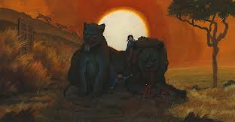
Figurative Language in “The Veldt”

Slide 2
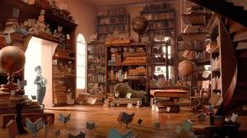
His wife paused in the middle of the kitchen and watched the stove busy humming to itself, making supper for four.
This house which clothed and fed and rocked them to sleep and played and sang and was good to them

Slide 3
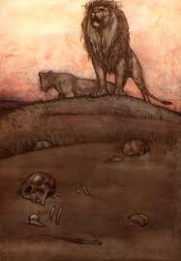
The nursery was silent. It was empty as a jungle glade at hot high noon.
The hot straw smell of lion grass, the cool green smell of the hidden water hole, the great rusty smell of animals, the smell of dust like a red paprika in the hot air.

Slide 4
……the papery rustling of vultures. A shadow passed through the sky.
And here were the lions now, fifteen feet away, so real, so feverishly and startlingly real that you could feel the prickling fur on your hand, and your mouth was stuffed with the dusty upholstery smell of their heated pelts,

Slide 5
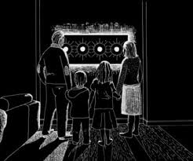
….and the yellow of them was in your eyes like the yellow of an exquisite French tapestry
The house is wife and mother now, and nursemaid.
But now, is yellow hot Africa, this bake oven with murder in the heat.

Slide 6
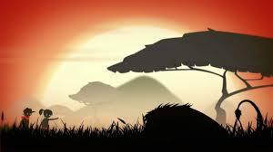
It was all right to exercise one's mind with gymnastic fantasies
The only flaw to the illusion was the open door through which he could see his wife, far down the dark hall, like a framed picture, eating her dinner abstractedly

Slide 7
I demand Aladdin!" he said. Nothing happened. The lions mumbled in their baked pelts.
Wendy and Peter were coming in the front door, cheeks like peppermint candy, eyes like bright blue agate marbles,
..a smell of ozone on their jumpers from their trip in the helicopter

Slide 8
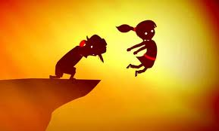
Wendy, come back here!" said George Hadley, but she was gone. The house lights followed her like a flock of fireflies
They went off to the air closet, where a wind sucked them like brown leaves up the flue to their slumber rooms.

Slide 9
"Who was it that said, 'Children are carpets, they should be stepped on occasionally'?
This room is their mother and father, far more important in their lives than their real parents
"I don't imagine the room will like being turned off," said the father. "Nothing ever likes to die - even a room." "I wonder if it hates me for wanting to switch it off?"

Slide 10
"Paranoia is thick around here today," said David McClean. "You can follow it like a spoor.”
We've been contemplating our mechanical, electronic navels for too long.
The house was full of dead bodies, it seemed. It felt like a mechanical cemetery. So silent

Slide 11
"I wish you were dead!" "We were, for a long while. Now we're going to really start living. Instead of being handled and massaged, we're going to live."
Lord, how did we ever get in this house? What prompted us to buy a nightmare?"

Slide 12
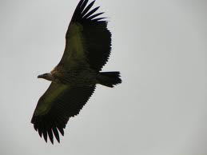
A shadow flickered over Mr. McClean's hot face. Many shadows flickered. The vultures were dropping down the blazing sky

