Slide 1
Vocabulary Study

Slide 2
assimilation
n. the process of receiving new facts or responding to new situations without struggle.

Slide 3
“Americans, both those who favor and who oppose assimilation, believe that for immigrants to assimilate, they must abandon their original cultural attributes.” (Peter Salins, 1997)

Slide 4
adaptation
n. adjustment to environmental conditions

Slide 5
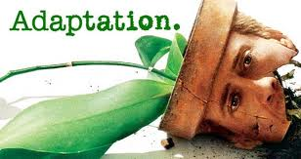
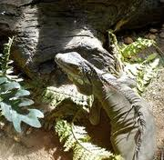
“Little is known about the adaptation process that these children must navigate, …as they learn a new culture, new community, and often, a new language.” (The New Jersey Immigrant Youth Project)

Slide 6
acculturation
n. cultural modification of an individual, group, or people by adapting to or borrowing traits from another culture

Slide 7
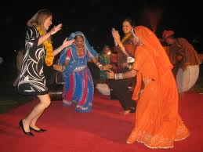
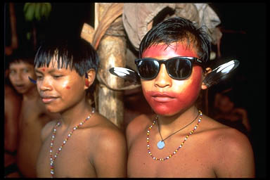
Immigrants bring their own cultural identity, language, values, beliefs, and behaviors. Acculturation is the gradual process of cultural exchange that immigrants undergo when they enter in contact with a new, host culture.

Slide 8
conflict
n. mental struggle resulting from incompatible or opposing needs, drives, wishes, or external or internal demands

Slide 9
Immigration often creates conflict between the immigrant and his new culture, or immigrants and their children who resist the traditional ways of their parents.

Slide 10
tone
n. the writer's attitude toward the material and/or readers expressed through his writing.

Slide 11
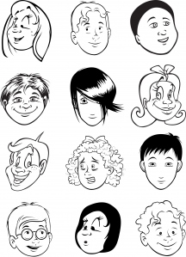
The choice of a single word can change the tone of a paragraph, even an entire essay. The tone can be casual, frivolous, dry, humorous, etc.

